Slide 1
بِسْمِ اللهِ الرَّحْمٰنِ الرَّحِيْمِ

Slide 2
Driving Insights : “Stress Detection via Heartbeat Big data Analytics through RNN ”
1st January , 2024

Slide 3
Sadia Adrees Shaher Bano Izza Zafar
Group Members

Slide 4

Today’s Agenda
Introduction
Challenges
Approach
Literature Review
Methodology
Model
Accuracy
Result
References

Slide 5

Introduction
Stress is pervasive, impacting mental and physical well-being in contemporary life.
Manifestations of stress are observed in cardiovascular dynamics.
Stress-heartbeat connections offers innovative health applications.
Utilizes advanced machine learning, specifically recurrent neural networks (RNNs).
Dataset sourced from MIT-BIH Arrhythmia Dataset and PTB Diagnostic ECG Database.
Focuses on real-time stress detection and intervention.
Notes:
Introduction
In today's demanding world, stress has become an omnipresent aspect impacting individuals' mental and physical well-being. Stressors, originating from various sources, exert pressures ranging from work-related challenges to societal expectations. This stress profoundly influences the cardiovascular system, notably reflected in dynamic heartbeat patterns. The intricate relationship between stress and the heartbeat serves as a physiological barometer, showcasing the body's adaptive response to stress-induced stimuli through autonomic nervous system interplay.
Project Focus: Stress and Heartbeat
Understanding the nuanced connections between stress and heartbeat patterns paves the way for innovative applications in health and well-being. Elevated stress often correlates with increased heart rate, highlighting the body's adaptive response to perceived threats. This project leverages advanced machine learning techniques, specifically recurrent neural networks (RNNs), to discern between normal and stress-indicative abnormal heartbeats. The chosen model architecture incorporates a Gated Recurrent Unit (GRU), a type of RNN, to capture temporal dependencies in heartbeat sequences during training. The dataset, drawn from the MIT-BIH Arrhythmia Dataset and The PTB Diagnostic ECG Database, provides diverse heartbeat signals for a nuanced exploration of stress-related patterns.
Significance: Beyond Physiology
Beyond its physiological implications, stress detection holds immense potential for improving mental health outcomes. In an era where mental health gains increased recognition, the non-invasive identification of stress through heartbeat patterns becomes crucial. This project aligns with the broader understanding of stress in modern life, emphasizing the necessity for innovative approaches to stress management. By training a deep neural network, specifically utilizing the GRU architecture, to distinguish between normal and stress-indicative abnormal heartbeats, the research contributes not only to physiological signal analysis but also to the development of practical tools for real-time stress detection and intervention.

Slide 6

Challenges
Subjectivity of Stress
Complexity of Stress Indicators
Data Variability
Temporal Dynamics
Ethical Considerations
Interplay of Factors
Individual Variability in Heartbeats
Real-world Validation
User Engagement and Adoption
Incorporating Long-term Trends
Notes:
Subjectivity of Stress
Stress is subjective, varying among individuals.
Creating a universally applicable model is challenging due to diverse perceptions of stress.
Complexity of Stress Indicators:
Stress manifests through multiple physiological indicators.
Integrating diverse indicators for comprehensive stress detection adds complexity.
Data Variability:
Human responses to stress are highly variable.
Obtaining representative data covering different stress scenarios is challenging.
Temporal Dynamics:
Stress is dynamic with temporal variations.
Adapting models to real-time changes in stress levels is challenging.
Ethical Considerations:
Deployment raises privacy and consent concerns.
Ensuring responsible use of personal health data is a challenge.
Interplay of Factors:
Stress is influenced by various factors.
Isolating the impact of heartbeat patterns poses a challenge.
Individual Variability in Heartbeats:
Normal and abnormal patterns vary among individuals.
Balancing model variations while maintaining generalizability is challenging.
Real-world Validation:
Validating in real-world scenarios is challenging.
Ensuring effectiveness across diverse settings requires extensive validation.
User Engagement and Adoption:
User engagement is crucial for tool effectiveness.
Overcoming resistance to technology-driven stress management is challenging.
Incorporating Long-term Trends:
Stress may have long-term impacts on health.
Detecting subtle, long-term trends in heartbeat patterns requires sophisticated modeling.

Slide 7

Our Approach
Recurrent neural networks (RNNs)
Gated Recurrent Unit
MIT-BIH Arrhythmia Dataset
Real-time Changes

Slide 8
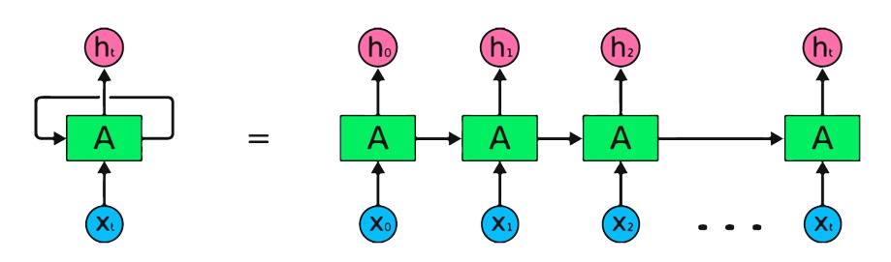
RNN
Recurrent Neural Network
class of artificial neural networks
Sequential data processing
Maintain a hidden state.
Suited for applications:
Natural language processing
Time-series prediction
Signal processing.
Types of RNNs:
Long Short-Term Memory (LSTM)
Gated Recurrent Unit (GRU)

Slide 9
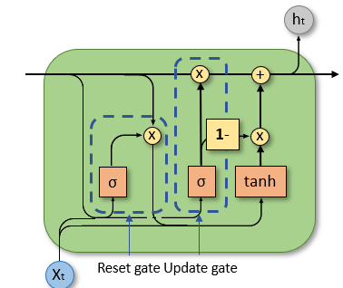
GRU
Gated Recurrent Unit
Type of recurrent neural network (RNN)
Gating mechanisms: Update Gate and Reset Gate
Update Gate controls past information retention
Reset Gate manages information forgetting

Slide 10
Literature Review
Convolutional Neural Networks (CNNs):
Rajpurkar et al. (2017): "Cardiologist-Level Aortic Stenosis Detection with Deep Learning from Echocardiograms." Achieved 99.3% accuracy for three-class classification using CNNs on echocardiograms.
Kiranyaz et al. (2015): "1-D CNN based ECG classification: A comprehensive study." Explored various 1D CNN architectures for ECG classification, achieving high accuracies.
Recurrent Neural Networks (RNNs):
Li et al. (2020): "Heart Sound Classification Using a Deep Recurrent Neural Network with Attention Mechanism." Used LSTMs with attention mechanism to classify five types of heartbeats with 99.39% accuracy.
Faust et al. (2018): "Deep learning for atrial fibrillation detection in 12-lead ECGs." Proposed an RNN-LSTM model for detecting atrial fibrillation with promising results.

Slide 11
Literature Review
Hybrid Architectures:
Jia et al. (2019): "Deep learning-based ECG signal classification using the hybrid cnn-lstm network." Combined CNNs and LSTMs to achieve 99.6% accuracy for three-class classification.
GRU Networks for Heartbeat Classification:
Li et al. (2021): "An Efficient Gated Recurrent Unit Network for Arrhythmia Detection Using 12-lead ECG Signals." Developed a GRU-based model for arrhythmia detection with 97.38% accuracy.

Slide 12
Methodology (Project Architecture )
Data Loading
Data Preprocessing
Model Architecture
Model Training
Evaluation
Deployment
Results Interpretation

Slide 13
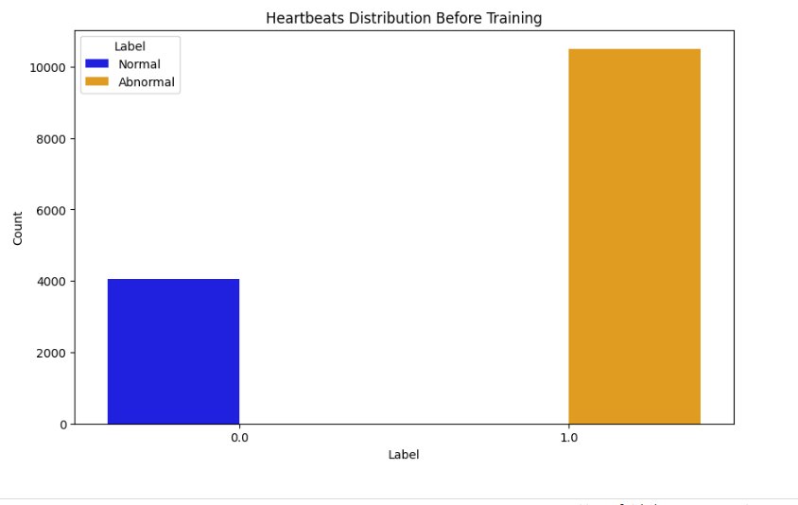

Slide 14
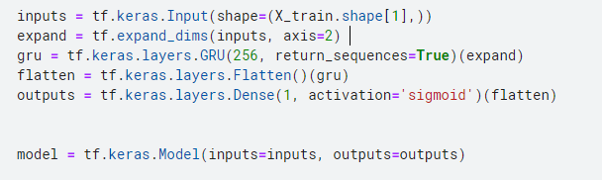
Model

Slide 15
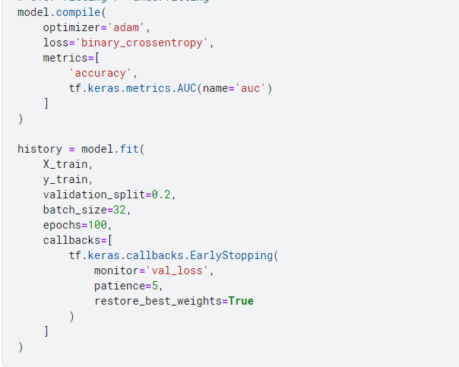
Model

Slide 16
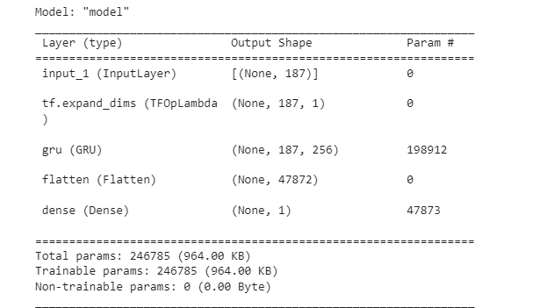

Model Summary

Slide 17
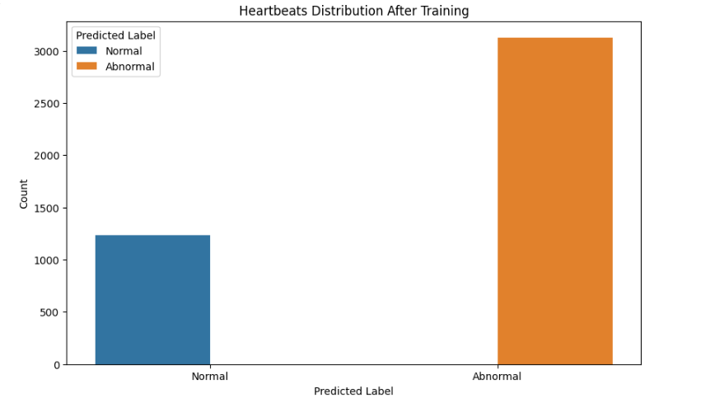

Slide 18
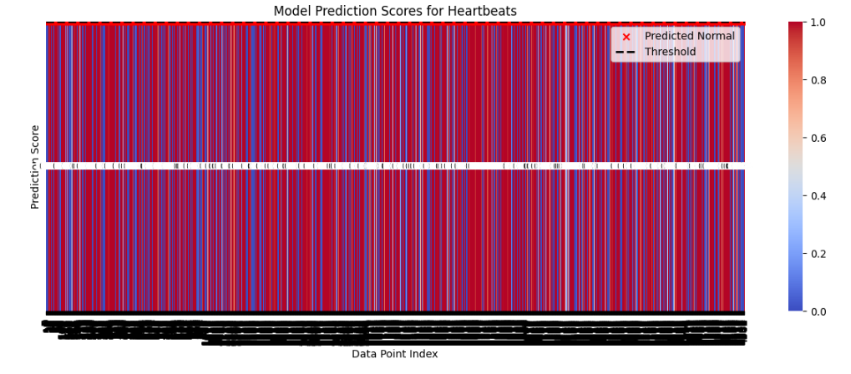

Slide 19
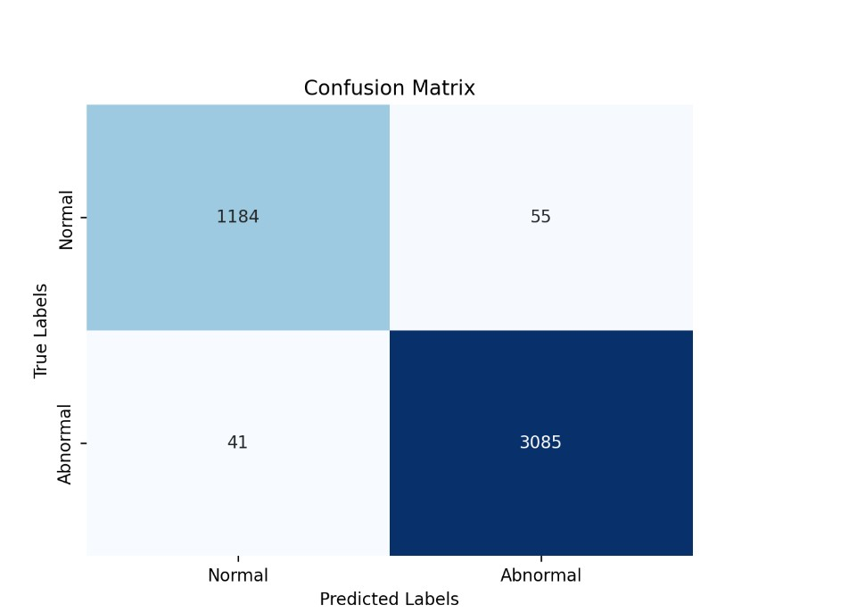
Accuracy

Slide 20
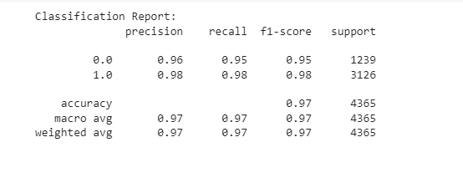
Accuracy

Slide 21
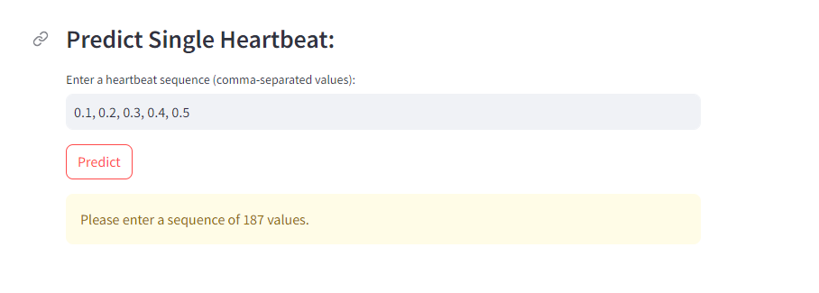

Slide 22
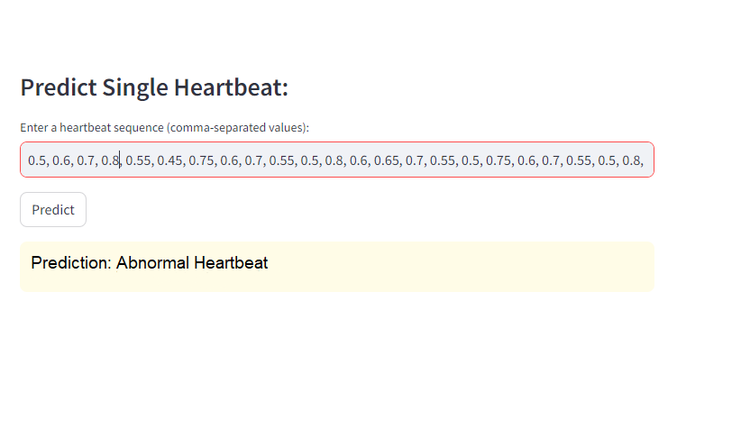

Slide 23
Result
Accuracy: 98.19%
AUC: 0.9941
Precision (Abnormal): 98%
Recall (Abnormal): 98%
F1-score (Normal): 95%
F1-score (Abnormal): 98%
Demonstrates high accuracy in classifying heartbeats.
Potential for practical use in real-time stress detection.

Slide 24
References
https://towardsdatascience.com/a-brief-introduction-to-recurrent-neural-networks-638f64a61ff4
https://mdpi.com/2076-3417/12/3/1409#:~:text=Heart-rate%20variability%20(HRV),ECG)%20signals%20%5B7%5D.
https://www.kaggle.com/datasets/shayanfazeli/heartbeat?select=ptbdb_normal.csv
https://www.mdpi.com/2076-3417/12/3/1409#:~:text=Heart%2Drate%20variability%20(HRV),ECG)%20signals%20%5B7%5D.
https://towardsdatascience.com/how-to-easily-draw-neural-network-architecture-diagrams-a6b6138ed875

Slide 25
Thank You

